Slide 1


Slide 2


Slide 3
The Calling
To pray, raise awareness, and raise funds
for Bible League International.

Slide 4
Volunteer Ambassadors
Act as a catalyst to change lives worldwide with God’s Word.
▪ Represent Bible League International in their local church and community.

Slide 5
Do you have a heart to put God’s Word in the hands of people around the world?
Do you want to join with others to expand the reach of a transformational ministry?

Slide 6
Bible League’s strategic initiatives serve:
Children and Youth
Church Growth
Prison Ministry
Through programs such as:
Bible Studies
Bible-based Literacy
Church Planter Training
Easy to Understand Translations

Slide 7
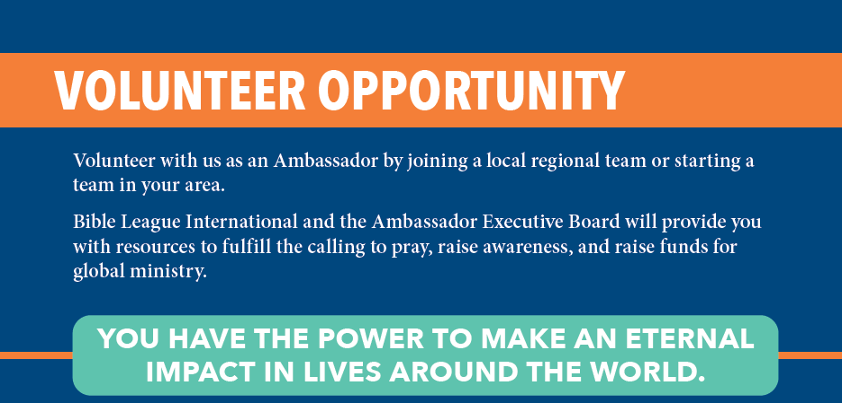

Slide 8
LOCAL:
  Ambassadors serve as a key contact for Bible League.
  Ambassadors share
    the fruitfulness of ministry,
    financial needs, and prayer requests.
  Ambassadors convey the needs of their church to Bible League for prayer and program support.

Slide 9
REGIONAL: Within regional areas, Ambassadors gather regularly to plan and implement awareness and fundraising events and to pray for Bible League ministry.

Slide 10
NATIONAL: Ambassadors meet twice annually to connect, share updates, hear from global ministry workers, and encourage one another in the Ambassador calling.

Slide 11
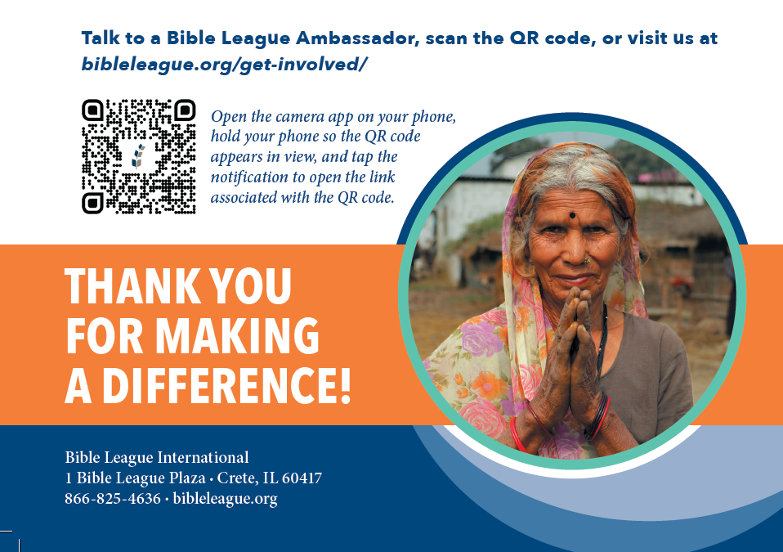
Talk to a Bible League Ambassador, scan the QR code, or
visit us at bibleleague.org/get-involved

